Slide 1



Script-to-Voice Solution: From Text to Natural-Sounding Audio
Team Name: Kirmada

Slide 2

Solution Overview
A pipeline: Text
Emotion Analysis
WaveNet Audio
Visual Story
Subtitled Video.
Voice Synthesis:
Uses Google Cloud Text-to-Speech API, offering 220+ voices across 40+ languages.
Supports SSML for fine-tuned pitch, speaking rate, and pauses based on detected emotions.

Slide 3

Input Handling
Goal: Process raw text scripts (stories) or transcribed audio (podcasts, interviews).
Preprocessing:
Text
Tokenization:
Text
Sanitization:
Emotion Tagging:
Tokenized text with [e.g., NLTK/Spacy] into sentences/words.
Sanitized: Removed special chars, fixed punctuation.
Prepared for WaveNet compatibility (e.g., SSML formatting).

Slide 4



Emotion Detection
Used [e.g., BERT] to classify emotions (happy, sad, angry) per sentence.
Trained on [e.g., Emotion Dataset] for precision.
Output: Labels to guide WaveNet voice modulation.

Slide 5

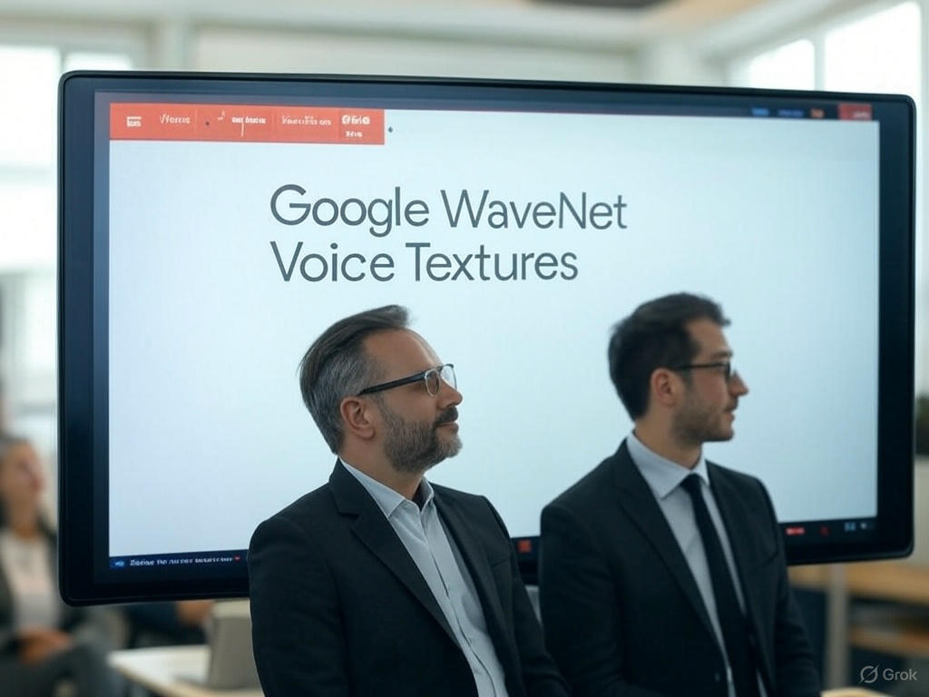

Voice Synthesis with Wavenet
01
Leveraged Google Cloud Text-to-Speech API with WaveNet models.
02
Emotion mapping: Happy → High pitch/fast, Sad → Low pitch/slow, Angry → Sharp/tense.
03
Customized via SSML: Adjusted pitch, rate, and pauses.

Slide 6


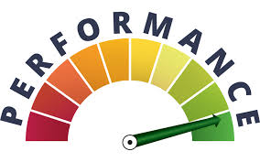
Visual Generation
Model
prompt
Performance:
Generated narrative images with OpenAI DALL-E from tokenized text.
Example: ‘Stormy sea’ → Visual frame.
Ensured scene coherence for video sync.

Slide 7



Video Assembly
"Merged WaveNet audio and images into video with [e.g., FFmpeg]."
"Synced audio timestamps to image transitions (<50ms drift)."
"Added subtitles from tokenized text in SRT format."

Slide 8






Technical Highlights & Scalability
Tech Stack:
Scalability:
Performance:
Python, NLTK/Spacy, BERT, Google WaveNet, OpenAI API, FFmpeg.
Google Cloud for batch processing 100+ scripts
10-min story in ~1 min, ~$0.016/1M chars (WaveNet pricing).

Slide 9



FINAL PITCH
"Stop hiring voice actors or wasting hours editing. Feed a script to our AI, pick a voice (or clone yours), and get studio-ready audio in seconds. Perfect for scaling content without sacrificing quality."

